Slide 1

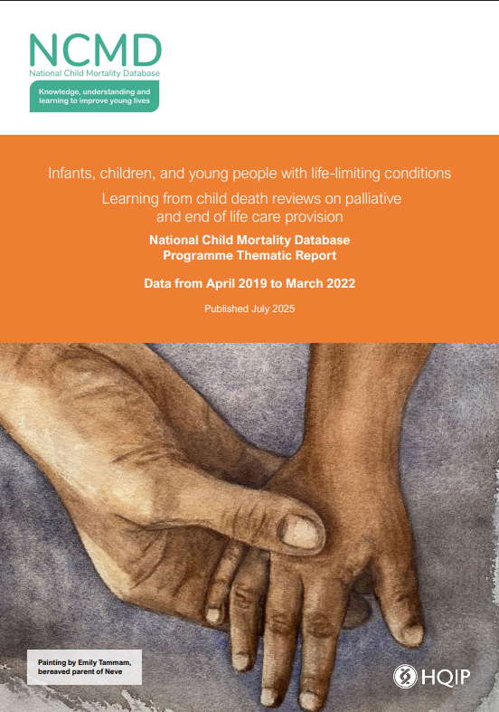
Infants, children, and young people with life-limiting conditions
National Child Mortality Database
Learning from child death reviews on palliative
and end of life care provision
Professor Karen Luyt
Director, NCMD
www.ncmd.info

Slide 2
Authors and advisory working group
National Child Mortality Database
Sylvia Stoianova, Tom Williams, David Odd, Vicky Sleap, James Fraser, Joanna Garstang and Karen Luyt – NCMD team
Emily Harrop - Oxford University Hospitals NHS Foundation Trust; Helen & Douglas House
Lorna Fraser - Cicely Saunders Institute of Palliative Care, Policy & Rehabilitation, King’s College London
Emily Tammam - Bereaved parent and lived experience contributor, Oxford
Emily Robertson - Regional Neonatal Intensive Care Unit, University Hospitals Bristol and Weston NHS Foundation Trust

Slide 3
Acknowledgements
National Child Mortality Database
Supported by: Kate Hayter, April Keogh, Nick Cook, Brian Hoy, Ghazala Jones, and Gaja Wright from the NCMD team
With thanks to:
Alex Mancini (National Lead Nurse for Neonatal Palliative Care) for reviewing the draft.
All Child Death Overview Panels (CDOPs) and Child Death Review Professionals who submitted data for the purposes of this report and for their continued support with information to NCMD for the national analysis and learning from child deaths in England.
All the families who shared their data, experiences, and stories.
Black Country CDOP for sharing their case study.
The authors of this report wish to acknowledge that the death of each child is a devastating loss that profoundly affects bereaved parents as well as siblings, grandparents, extended family members, friends and professionals.

Slide 4

National Child Mortality Database
Cover image painted by Emily Tammam, bereaved parent of Neve.
The hands represent the relationships and connections at the heart of birth, life, and death. These include all the connections between and among health professionals, families and children. As a bereaved parent, I remember the soft feel of my daughter Neve’s hand, from that of a tiny infant through to her bedside, in hospital, in our hospice and ultimately, at home, just before and just after her death.
The patches of light on the hands are rays of sunlight and they represent our experience of palliative care; it brought glimmers of light, when everything felt heavy and overcast. Sometimes palliative care felt like an umbrella, shielding us from the rain and other times, like sunshine, when it was otherwise dark. We could not stop Neve dying but as a team, we could ease some of her suffering. In the time when we knew and understood that our daughter would die, it was palliative care that brought us this warmth, connection, and support.

Slide 5
Life-limiting conditions
National Child Mortality Database
Life-limiting conditions are defined as those for which there is no reasonable hope of cure and from which children may die¹. Some conditions cause progressive deterioration, meaning that the child becomes increasingly dependent on parents and carers.
Previous studies have shown that the number of children living with life-limiting and life-threatening conditions is increasing². There is also evidence that children with these conditions are living longer.
This means that more children and young people will require support from palliative care and end of life services.
Together for Short Lives (2018) A Guide to Children’s Palliative Care, Fourth Edition. Available at: https://www.togetherforshortlives.org.uk/app/uploads/2018/03/TfSLA-Guide-to-Children%E2%80%99s-Palliative-Care-Fourth-Edition-5.pdf
Together for Short Lives (2020) Make Every Child Count. Available at: https://www.togetherforshortlives.org.uk/resource/make-every-child-count/
www.ncmd.info
@NCMD_England

Slide 6
Palliative care
National Child Mortality Database
We need to understand what is currently working and where improvements are needed.
Palliative care for children with life-limiting or life-threatening conditions is an active and total approach to care. This care can last from the point of diagnosis all the way through the child’s life and their death¹.
It embraces physical, emotional, social, and spiritual elements, and focuses on enhancing the quality of life for the child and support for the family. This care includes the management of distressing symptoms, provision of short respite breaks for children and families, and care through death and bereavement.
Together for Short Lives (2018) A Guide to Children’s Palliative Care, Fourth Edition. Available at: https://www.togetherforshortlives.org.uk/app/uploads/2018/03/TfSLA-Guide-to-Children%E2%80%99s-Palliative-Care-Fourth-Edition-5.pdf
www.ncmd.info
@NCMD_England

Slide 7

Thematic Report: Children with Life-Limiting Conditions and Palliative and End-of-Life Care Needs
National Child Mortality Database
Analyses data from the child death reviews in England of children who have died with, but not necessarily of, a life-limiting condition.
Died in the period between 1 April 2019 and 31 March 2022 (3 years).
Reports the characteristics of the children who have died and an analysis of the national themes and learning on palliative care services, as recorded in the completed reviews by the Child Death Overview Panels (CDOPs).
www.ncmd.info
@NCMD_England

Slide 8

Methodology
National Child Mortality Database
Children in England who are born alive (at any gestational age) and die before their 18th birthday, excluding stillbirths and legal terminations of pregnancy.
Children who died with a life-limiting condition were identified by:
i. having any hospital admission with an ICD-10 diagnosis code representing a life-limiting condition (as used in previous research¹), or
ii. the supplementary reporting form ‘death of a child with a life-limiting condition’ was selected by the CDOP.
Fraser, L. K., Gibson-Smith, D., Jarvis, S., Norman, P., & Parslow, R. C. (2021) ‘Estimating the current and future prevalence of life-limiting conditions in children in England’, Palliative medicine, 35(9), 1641–1651. Available at: https://doi.org/10.1177/0269216320975308
www.ncmd.info
@NCMD_England

Slide 9
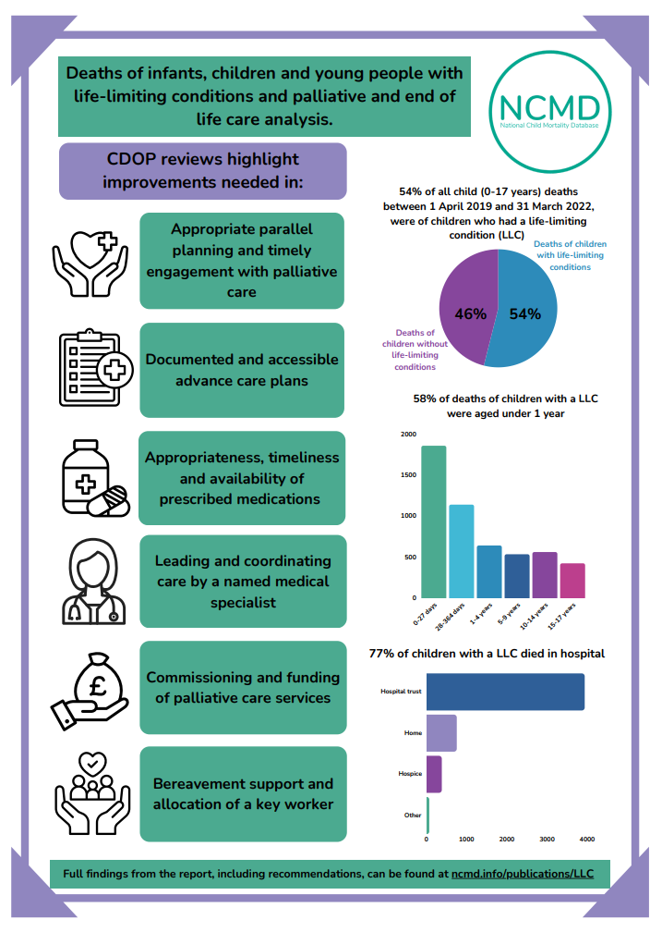
National Child Mortality Database
54% of all child (0-17 years) deaths between 1 April 2019 and 31 March 2022, were of children who had a life-limiting condition
www.ncmd.info
@NCMD_England

Slide 10
1. Characteristics of children who die with a life-limiting condition
National Child Mortality Database

Slide 11
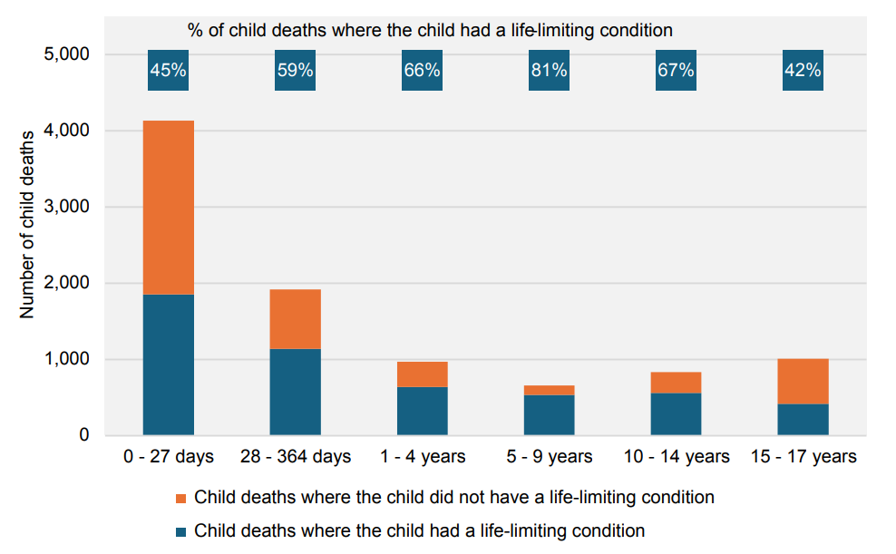
Age
National Child Mortality Database
54% of all child (0-17 years) deaths were of children who had a life-limiting condition - similar to the proportion in Wales reported previously (53%).
This proportion varied by age, with the highest proportion in those aged 5-9 years (81%) and the lowest in those aged 15-17 years (42%).
However, the highest number of deaths of children with a life-limiting condition was in the neonatal (0–27 days) age group, followed by those aged 28–364 days. These two age groups (infant deaths) represented 58% of deaths of children with a life-limiting condition.
www.ncmd.info

Slide 12
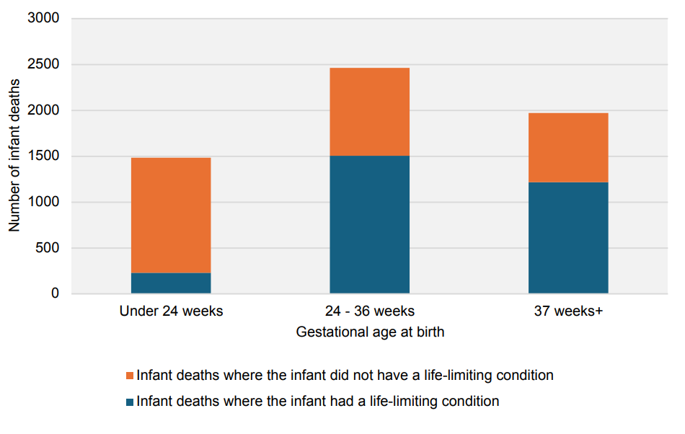
Gestational age
National Child Mortality Database
Where it was known, 59% (n=1733/2952) of infants (under 1 year) who died with a life-limiting condition were born prematurely (before 37 weeks’ gestation).
Infants born at the earliest gestational ages (e.g., before 24 weeks) are at extremely high risk of developing a life-limiting condition, and some groups have proposed that these high risk groups should be supported by palliative care teams by default.
However, in this report, preterm birth at any gestation, was not considered a life-limiting condition in itself before the development of one or more life-limiting conditions.
www.ncmd.info

Slide 13
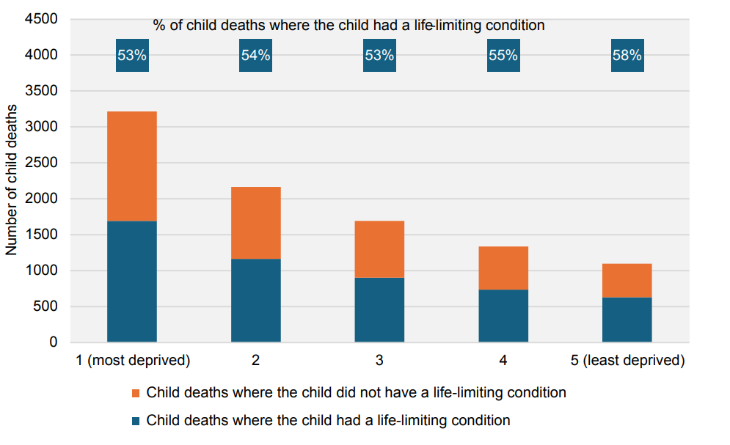
Social deprivation
National Child Mortality Database
There were higher numbers of deaths of children with and without a life-limiting condition in the most deprived neighbourhoods in comparison to the least deprived neighbourhoods.
Previous research has shown there is an association between the risk of child death and the level of deprivation for most causes of death¹.
National Child Mortality Database (2021) Child Mortality and Social Deprivation Thematic Report. Available at: https://ncmd.info/wpcontent/uploads/2021/05/NCMD-Child-Mortality-and-Social-Deprivationreport_20210513.pdf
www.ncmd.info

Slide 14
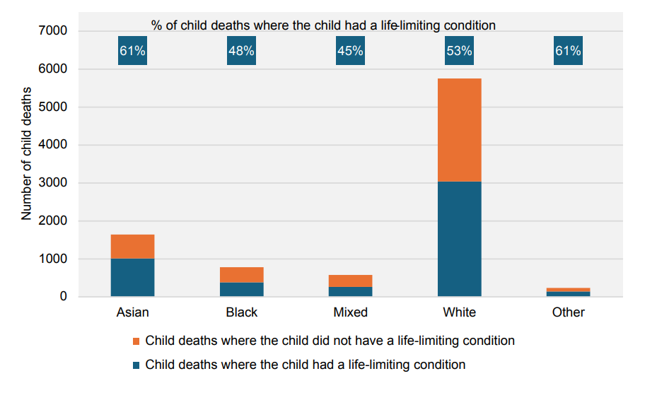
Ethnicity
National Child Mortality Database
Of all deaths of children from an Asian or other ethnic backgrounds, 61% had a life-limiting condition.
This was higher than the proportion of deaths where the child had a life-limiting condition across white (53%), black (48%), or mixed (45%) ethnic backgrounds.
www.ncmd.info

Slide 15
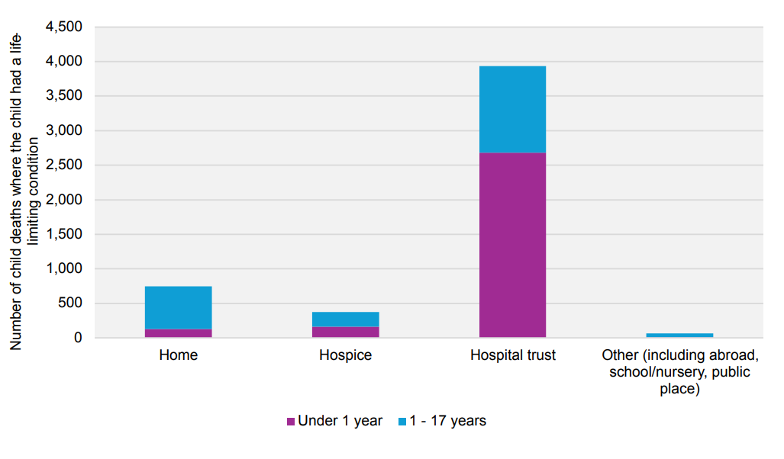
Place of death
National Child Mortality Database
Number of child deaths where the child had a life-limiting condition, by place of death
Of children who died with a life-limiting condition, 77% died in a hospital trust, 15% died at home, 7% died in a hospice.
These proportions are similar to those reported previously and have been reported for nearly 20 years¹.
Gibson-Smith, D., Jarvis, S.W., Fraser, L.K. (2021) ‘Place of death of children and young adults with a life-limiting condition in England: a retrospective cohort study’, Archives of Disease in Childhood 2021;106:780-785. Available at: https://adc.bmj.com/content/106/8/780
www.ncmd.info

Slide 16
Place of death
National Child Mortality Database
Number of child deaths where the child had a life-limiting condition, by place of death
For under 1s:
90% died in a hospital trust, 5% in a hospice, 4% at home.
For 1-17-year-olds:
59% died in a hospital trust, 10% died in a hospice, 29% at home.
www.ncmd.info

Slide 17
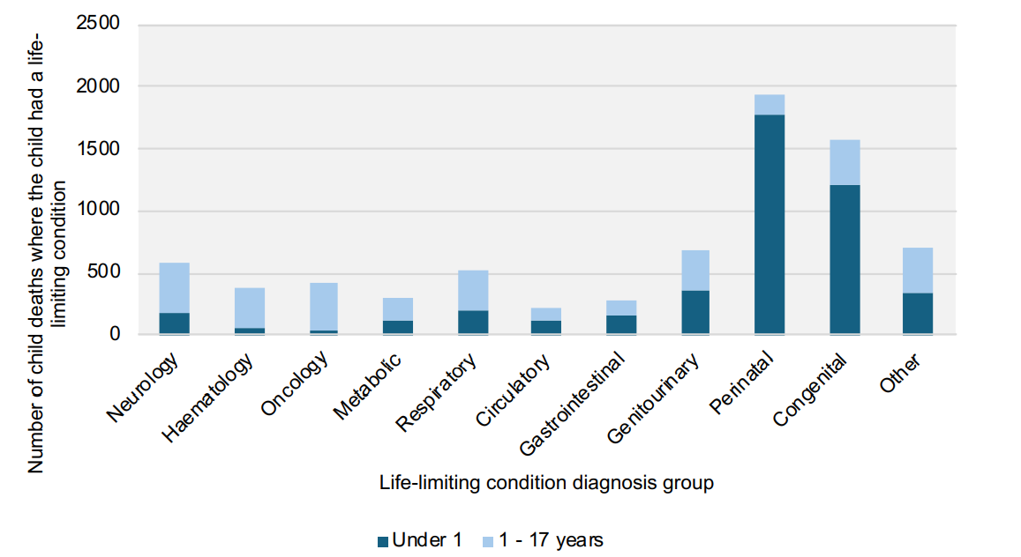
Diagnoses
National Child Mortality Database
Number of child deaths where the child had a life-limiting condition, by diagnosis group
The highest number of deaths occurred in children with an underlying perinatal (39% of deaths of children with a LLC) or congenital life-limiting diagnosis (35%)
N.B. Categories are non-exclusive: a death may be recorded under multiple categories.

Slide 18
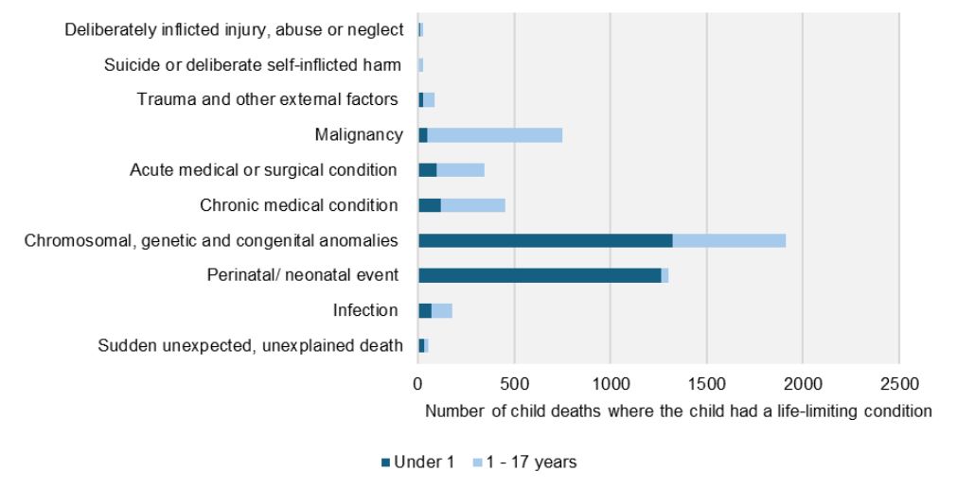
Category of death
National Child Mortality Database
Number of child deaths where the child had a life-limiting condition, by primary category of death
CDOPs categorised the deaths of children with a life-limiting condition across all ten categories.
The most common primary categories of death recorded by CDOP were Chromosomal, genetic and congenital anomalies (37% of deaths of children with a life-limiting condition), Perinatal /neonatal event (25%), and Malignancy (15%).

Slide 19
Additional data
National Child Mortality Database
Additional data is available in the data tables, including breakdowns by sex, region, mode of death and ICB to support service planning.

Slide 20
2. National themes identified from CDOP reviews
National Child Mortality Database

Slide 21
Methodology
National Child Mortality Database
This section focuses on learning from child death reviews on the provision of palliative care services and bereavement support.
Reports the data from deaths where the supplementary reporting form ‘death of a child with a life-limiting condition’ was completed.
39% of all deaths of children with a life-limiting condition (reported in the first section) had this form selected. One reason for low completeness is that there are many other supplementary reporting forms that could apply to this cohort (e.g., ‘deaths on a neonatal unit’, ‘death of a child with an oncology condition’).
Therefore, important to note that the learning in this section may not be representative of all age groups and causes of death for children with a life-limiting condition.
www.ncmd.info
@NCMD_England

Slide 22
National Child Mortality Database
There were many examples of excellent coordinated multi-disciplinary care, regular engagement with families, compassionate end of life care and bereavement support for the families of the children who died.
However, this section focuses on the national themes of key issues identified by CDOPs on what further work is needed to improve services.
www.ncmd.info
@NCMD_England

Slide 23
Appropriate parallel planning and engagement with palliative care
National Child Mortality Database
Parallel planning is where palliative care is offered in parallel with (at the same time) and alongside curative treatment or treatment aimed at significantly prolonging life.
There were 109 reviews which reported no evidence of appropriate parallel planning and no engagement with palliative care from healthcare professionals.
Learning around improving parallel planning was reported in the reviews, often around the importance of earlier parallel planning and referral to the palliative care team.
A palliative care plan may be offered and discussed with the perinatal team / treating team without a referral to specialist palliative care services, as per the BAPM Framework (2024) guidance on perinatal palliative care.
www.ncmd.info
@NCMD_England

Slide 24
Appropriate parallel planning and engagement with palliative care
National Child Mortality Database
CDOPs reported missed opportunities to instigate parallel planning during previous hospital admissions and highlighted the need for increased knowledge of hospital teams.
CDOPs highlighted cases where parallel planning and palliative care were offered but declined. This could be due to many different reasons, such as preference for acute intervention and curative treatment.
It is possible that one factor may be how well the offer of palliative care is made by healthcare professionals. Embedding palliative care in clinical teams can improve the understanding that palliative care is an integral part of the overall care for the child.
www.ncmd.info
@NCMD_England

Slide 25
Appropriate parallel planning and engagement with palliative care
National Child Mortality Database
Reviews also highlighted that if there is a diagnosis of a life-limiting condition during pregnancy, then there is a need to consider parallel planning and potential involvement of palliative care teams in the antenatal period. There were examples in the reviews of fragmentation of care, where those caring for the family after birth had not been involved during the pregnancy.
www.ncmd.info
@NCMD_England

Slide 26

Named medical specialist
National Child Mortality Database
NICE Quality Standard 160 states that children and young people with a life-limiting condition should have a named medical specialist responsible for leading and co-ordinating the care of the child. This is reiterated in the framework for palliative care in perinatal medicine by the British Association of Perinatal Medicine.
The importance of having a named medical specialist for each child was highlighted in the reviews. The absence of a named medical specialist may lead to poor co-ordination and oversight of care across services, difficulties in communication, lack of advocacy for the family, and potential missed opportunities to consider a long-term view of a child’s health status, especially their trajectory towards the end of life.
www.ncmd.info
@NCMD_England

Slide 27
Advance care planning
National Child Mortality Database
Advance care planning offers children, young people and their parents and carers the opportunity to plan future care, support and wishes and involves developing and recording an advance care plan (ACP). It is an important part of the care for children with life-limiting conditions as outlined in the NICE guidance NG61
CDOPs have identified 235 cases where there was no ACP in place at the time of the child’s death. In 138 reviews, there was no symptom management plan in place.
Some of the reasons recorded in the CDOP review were:
  Advance care planning was offered to the family, but it was declined by them.
  Ongoing treatment or the healthcare professional thought advance care planning was not immediately relevant (e.g., the child was felt not to be at the end of life stage; the child was not at a stage in their disease progression that advance care planning would normally be considered appropriate)
www.ncmd.info
@NCMD_England

Slide 28
Advance care planning
National Child Mortality Database
Further reasons included:
  No formal ACP was in place but there were symptoms management plans, DNACPR, palliative and end of life care planning, and key conversations (on wishes, goals, locations of care) had been carried out between medical teams, hospices and family.
ACPs should be developed antenatally with parents and carers for a baby diagnosed during pregnancy. CDOPs highlighted the importance of improved communication, early palliative care referral and conversations, as well as ensuring the ACP is shared with all teams and care providers.
www.ncmd.info
@NCMD_England

Slide 29
Advance care planning
National Child Mortality Database
CDOPs have identified cases where an ACP was in place at the time of the child’s death but was not followed. Families may feel distressed for their child and call emergency services for support in the moment of crisis. CDOPs identified that when such situations occur, the attending ambulance crew may not have access to the ACP, or, if it is found, the details on the family’s wishes for resuscitation may not be quickly accessible.
This can lead to full resuscitation being implemented and, in a few instances, to the police being contacted as part of the Sudden Unexpected Death in Childhood protocol. This causes considerable additional distress to a family who have taken care to plan a peaceful death with their care team.
www.ncmd.info
@NCMD_England

Slide 30

Prescribing or drug delivery issues
National Child Mortality Database
Effective symptoms management depends on the appropriateness and timeliness of the prescribed medications. Symptoms can change quickly, and patients may be cared for by different providers in multiple settings – in a hospital, hospice and / or at home.
Issues related to prescribing or problems with drug delivery were identified in 160 reviews. The following themes were identified:
Difficulties with access to appropriate medication. Including: issues with drug supply locally/nationally, slow responses by GPs in prescribing, or pharmacies in dispensing, symptom management drugs.
Examples of miscommunication / lack of understanding regarding GPs not being able to prescribe certain drugs, such as specialist medicines that can only be prescribed by specialist clinicians (also known as red drugs).
www.ncmd.info
@NCMD_England

Slide 31
Prescribing or drug delivery issues
National Child Mortality Database
Issues with medications on discharge from hospital e.g., delays, medications not appropriately dispensed, patients being transferred without an updated medical report or list of medications.
Challenges with administration of medication in the hospice due to lack of appropriate protocols for IV fluids to be delivered in this setting, or the hospice not delivering total parenteral nutrition.
Issues with administration of subcutaneous drugs or fluids at home. Reported issues included the lack of 24-hour nursing support over the weekends for setting up syringe drivers at home, and delays in the delivery of the syringe driver when first commenced.
Insufficient skill mix in prescribing. Reviews highlighted that more education is required on end of life drugs.
www.ncmd.info
@NCMD_England

Slide 32
Use of cold bedroom or cot after death
National Child Mortality Database
Cooling facilities (e.g., cold bedroom, cold cot / blanket) can help families with the initial grieving process immediately after a child’s death.
In 480 of the reviews, it was recorded that cold bedrooms/cots were not used. In most cases, the families were offered the use of a cold bedroom/cot, but families did not wish to use them. There could be many reasons why families did not wish to use the facilities, including religious or cultural preferences.
In 32 reviews, cold bedrooms/cots were not used due to the requirement for a post-mortem examination or coroner investigation.
Other reviews reported restrictions due to the COVID-19 pandemic meant that these facilities were not offered, and a further 20 cases unrelated to the pandemic where the cooling facilities were not offered, not available or not working.
www.ncmd.info
@NCMD_England

Slide 33
Commissioning and funding of palliative care services
National Child Mortality Database
Inconsistent funding arrangements for paediatric (including perinatal / neonatal) palliative care across regions of the country has been previously highlighted¹. This was also recently highlighted in Built to Last? The state of children’s palliative care in 2025 report.
There were 54 reviews where gaps in palliative care service provision were recorded by CDOPs.
These related to situations where the service was either not commissioned or not funded. The majority of these reviews highlighted that, in some regions, there is a lack of routine 24-hour access to community nursing services, and out of hours palliative care is not a fully commissioned service for the children's community nursing team.
Papworth, A., Hackett, J., Beresford, B. et al (2023) ‘Regional perspectives on the coordination and delivery of paediatric end-of-life care in the UK: a qualitative study’, BMC Palliat Care 22, 117 (2023). Available at: https://doi.org/10.1186/s12904-023-01238-w
www.ncmd.info
@NCMD_England

Slide 34
Commissioning and funding of palliative care services
National Child Mortality Database
NICE Guideline QS160 states that any child approaching the end of their life and being cared for at home should have 24-hour access to both paediatric nursing care and palliative care advice. This could include a service that provides extended hours for face-to-face services, with 24-hour access to phone support from a palliative care specialist.
Many of the teams involved had been supporting children and their families solely on a good will basis, with healthcare professionals often working outside their normal working hours. This was necessary to fill gaps in services, to provide support and advice, and to enable the child to die in their location of choice. Such additional work placed significant responsibility on teams, often without any formal recognition.
www.ncmd.info
@NCMD_England

Slide 35

Commissioning and funding of palliative care services
National Child Mortality Database
Even where out of hours services were commissioned, capacity issues of existing services were noted, with difficulties in staff recruitment, retention and skill base. The challenge of ensuring a safe and sustainable service was recorded.
The Association for Paediatric Palliative Medicine and the Royal College of Paediatrics and Child Health have previously highlighted concerns about workforce capacity and insufficient deanery national training numbers are allocated to junior doctors wishing to sub-specialise in paediatric palliative care. The Built to Last? report recommends that the UK Government should expand the children palliative care workforce, to include increased spending on specialist paediatric palliative medicine GRID and SPIN training.
www.ncmd.info
@NCMD_England

Slide 36
Bereavement support for families
National Child Mortality Database
Bereavement support may be provided by various different professionals including bereavement midwives, hospice teams and charities. For neonatal deaths, neonatal nurses may provide this during the neonatal admission, sometimes antenatally.
Bereavement support was not offered in 14 of the reviews.
Reviews highlighted issues with communication and the need to ensure clear communication between teams before and after the death of the child. A collaborative approach to bereavement support is required to ensure duplication is avoided and gaps are identified.
www.ncmd.info
@NCMD_England

Slide 37
Bereavement support for families
National Child Mortality Database
A key worker must be appointed for all bereaved families in line with the Child Death Review Statutory & Operational Guidance. It is important that there is collaboration and clear communication between hospice, hospital (including palliative care, neonatal and midwifery bereavement teams) and community staff when identifying an appropriate lead bereavement key worker.
Timely referral to palliative care for parallel planning supports better planning and communication around bereavement support. Where there is a diagnosis of a life-limiting condition during pregnancy, it is important that the bereavement team is informed antenatally, to improve co-ordination and involvement in care planning.
www.ncmd.info
@NCMD_England

Slide 38
National Child Mortality Database
Limitations
NCMD is reliant on accurate data being inputted by professionals involved in submitting information for the child death review.
For deaths between 1 April 2019 – 31 March 2022, 96% had been reviewed by a CDOP before 1 February 2025. Therefore, there will be a small underestimation.
Using previous hospital admission diagnoses codes to identify children with a life-limiting condition has limitations to consider e.g., some children whose life-threatening event was no longer life-limiting may have been included, for example, a cancer diagnosis that was cured.
More information can be found in the Supporting Material.
www.ncmd.info

Slide 39

3. Recommendations
National Child Mortality Database

Slide 40
Commissioning
National Child Mortality Database
CYP with life-limiting conditions should be cared for by a defined multi-disciplinary team that enables assessment, management, and 24-hour telephone advice 7 days a week. NHS England has developed statutory guidance to support Integrated Care Boards with their duty to commission palliative care services and service specifications for palliative and end of life care for CYP.
We ask Integrated Care Boards in collaboration with Operational Delivery Networks to:
1. Review commissioning arrangements to ensure all infants (including those who are preterm), children and young people with life-limiting conditions have 24-hour access to community nursing teams, specialists in paediatric palliative care, and other appropriate healthcare professionals as required, and especially at the end

Slide 41
Commissioning
National Child Mortality Database
All families should have timely bereavement support, before and after a death, as appropriate. Bereavement support should be flexible and holistic, ensuring the individual needs of each family, including siblings, are met.
We ask Integrated Care Boards, Local Authorities, NHS providers to:
2. Ensure all bereaved families are allocated a key worker, in line with the Child death review statutory and operational guidance. The key worker post should be funded and embedded appropriately as per the guidance.

Slide 42
Education
National Child Mortality Database
All parents and carers of children and young people with life-limiting conditions require information and opportunities to discuss parallel planning which should be documented in an advance care plan.
We ask The Royal College of Paediatrics and Child Health, Association of Paediatric Palliative Medicine, The College of Paramedics to:
3. Ensure all named medical specialists working with infants, children and young people receive and complete appropriate training in parallel planning and documenting advance care plans (e.g., the Recommended Summary Plan for Emergency Care and Treatment (ReSPECT) form and the Children and Young Person’s Advance Care Plan (CYPACP) document).

Slide 43
Education
National Child Mortality Database
All advance care plans should contain up to date and easily accessible information on resuscitation that can be found quickly in high pressure situations.
We ask:
4. Integrated Care Boards working with care providers looking after children with life-limiting conditions should ensure that the ReSPECT / resuscitation document is easily visible. In hospital trusts this might include adding it to the ‘banner’ bar of the electronic patient record.

Slide 44
Medicines
National Child Mortality Database
Children and young people with planned end of life care at home require timely access to oral and subcutaneous medications to relieve distressing symptoms.
We ask Integrated Care Boards, Royal College of General Practitioners, Royal Pharmaceutical Society to:
5. Ensure timely access to essential medications needed for the delivery of end of life care at home. This should include parenteral medication for subcutaneous infusions and medications needed off label or beyond their licence (as this is frequently the case in paediatric palliative care).

Slide 45
Next steps and future priorities
National Child Mortality Database
Analysis in this report has identified a key area where further research is needed:
• What are the barriers to providing timely access to safe and effective medications for delivery of end of life care in the home setting?
Further research recommendations related to the themes highlighted within this report have previously been made in NICE Guideline NG61, including:
• What is the impact of offering timely perinatal palliative care on the experience of bereaved families?
• When planning and managing end of life care what factors help children and young people with life-limiting conditions and their parents or carers to decide where they would like end of life care to be provided and where they prefer to die?
• What is the effectiveness of a home based package of care as opposed to hospital or hospice care?

Slide 46
Further information
National Child Mortality Database
The full thematic report can be found at: www.ncmd.info/publications/LLC
Including:
Foreword (provided by Nick Carroll, Chief Executive, Together for Short Lives)
Main Report & Easy Read Report
Data Tables
Families’ Stories
Case Studies

Slide 47
Keep in touch
National Child Mortality Database
Follow
us on X (formerly Twitter) @NCMD_England
Bluesky at https://bsky.app/profile/ncmd.bsky.social
Visit
our website at www.ncmd.info
Sign up
to our mailing list here to be notified of future events and publications
Look at
Our web pages for professionals here

