Slide 1
Capturing data on immigration status- relevance to child deaths
Pip McKnight

Slide 2
Healthy Migrant Paradox
Originated in observations of Latino migrants in the USA
Healthiest populations migrate and arrive in receiving country in equivalent or better health than home population
Health advantage deteriorates over time
Explained in part through socio-economic and structural disadvantage

Slide 3
Asylum seeker, refugee or migrant?
Asylum Seeker
Refugee
A person who has lodged an application for protection on the basis of the 1951 Refugee Convention or Article 3 of the European Convention of Human Rights
A person who ‘owing to a well-founded fear of being persecuted for reasons of race, religion, nationality, membership of a particular social group, or political opinion, is outside the country of his nationality and is unable to or, owing to such fear, is unwilling to avail himself of the protection of that country’ (1951 Refugee Convention)
Someone who has been granted refugee status

Slide 4
Migrant
Varied definitions of the term “migrant”
Often denotes intention to stay in a country temporarily or movement between countries
Associated with immigration for economic reasons rather than to escape human rights abuses (eg EU migrants)
Migrants subject to negative stereotyping in press and public debate (“illegal migrant”)
Important distinction between migrants and asylum seekers/refugees

Slide 5
Entitlement to NHS care
Primary Care
Free of charge for asylum seekers, refused asylum seekers and refugees
Secondary Care
Full access for refugees and those with an active asylum claim
NI, Scotland and Wales- full access for anyone who has made a claim for asylum
England- refused asylum seekers/undocumented only entitled to immediately necessary/urgent care free of charge
Migrants
NHS treatment not classed as a ‘public fund’ and can be accessed regardless of immigration status
Immigration Health Surcharge

Slide 6
Immigration status as a social determinant of health
Social Determinants of Health
Economic Stability
Health & Health Access
Social & Community Context
Education
Neighbourhood and Built Environment
Social Determinants in the UK Asylum System
Enforced poverty
Poor health captial/barriers to health access
Marginalisation/ poor & disrupted social networks
Barriers to information/ professional ignorance
No-choice, low quality housing and dispersal

Slide 7
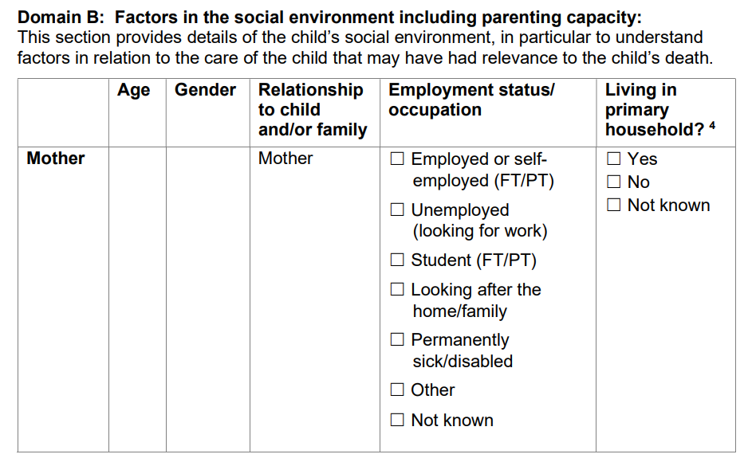
Considering immigration status in the social environment
Notes:
Pg 9/10
Recommend inclusion of insecure immigration status as factor in social environment (including right to work, NRPF)

Slide 8
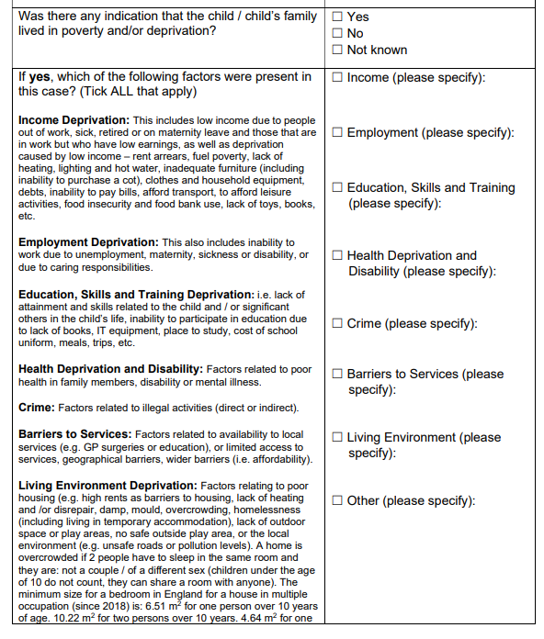
Considering deprivation caused by immigration status
Notes:
Pg 11
Currently not captured but will be in future- we will be working with NCMD

Slide 9
Be informed
Understand differences in immigration and rights, entitlements and restrictions
Understand charging regimes and wider context influencing decision-making and access to health services
Don’t be afraid of asking but ensure patients understand why and how information will be used
More information:
BMA Refugee and Asylum Seeker Toolkit
Doctors of the World
Migrant Health Guide (GOV.UK)

