Slide 1




Talking About Lactation:
The Importance of
Shared Decision Making
in Antenatal Anticipatory Care Planning
22nd October 2024
Laura Atherton – The Milk Bank at Chester
Sara Balmforth – Perinatal Midwife
Rowen Emmett-O’Toole – Parent Voice

Slide 2
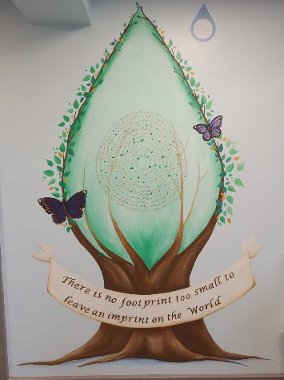
The Memory Milk
Gift Initiative
Committed to raising awareness of Lactation Choices after Loss, educating health care professionals and facilitating milk donation if that is the decision of the parent
National Initiative supporting all 14 UK milk banks ran by the Milk Bank at Chester based at the Countess of Chester
We have supported over 200 families to donate milk in memory of their baby in just under 3 years
Launched in October 2021 in response to a mother – Holly - who wished to donate milk after initiating lactation following the stillbirth of her son Bodhi
Supporting families with Memory Making

Slide 3
Lactation Choices Following an Antenatal Diagnosis
As diagnostic technology and fetal medicine advance, the prevalence of life- limiting fetal diagnoses made antenatally increases
Families may experience anticipatory grief and may face difficulties parallel planning whilst making memories
Anticipatory Care Planning is considered best practice, and a palliative care birth plan should enable families to discuss their wishes and receive compassionate support whilst making informed choices

Slide 4
National Observations
Patient Unmet Need – families are not being routinely provided with information about lactation management following an antenatal diagnosis or following a loss
HCP Unmet Educational Requirement – HCPs self report that they have concerns around discussing lactation choices
Recognised Need For Change – how are families expected to make informed decisions if they are not provided with enough or any information about the choices available
No Clinical Data Reporting Process – Have families been offered choice? How can this be reviewed locally or nationally? How is this being reported?

Slide 5
The Patient Unmet Need
We will now hear some parent voices talking about their experiences and choices surrounding lactation after loss

Slide 6
“I was given full information and the time to decide which I was so grateful for, and I opted for medication to express my milk”

Slide 7
“I wasn’t even warned that my milk would come in”

Slide 8
“This was the one area of care I wished had been a bit easier to access information on…but no one was forthcoming with information”

Slide 9
“It’s amazing how many people think you shouldn’t mention it for fear of putting pressure on mothers rather than giving them the choice”

Slide 10
“Following a TFMR I was told my milk would come in and told how to stop it/not encourage it- I wasn’t told I could have donated it which I would have really liked”

Slide 11
Reflection
Have you been aware of any conversations like this?
Were you surprised by any of the parent statements?
How did reading them make you feel?
Whose role do you think this is?
Is there anything you would have done differently?
Would it make you do anything differently in the future?

Slide 12
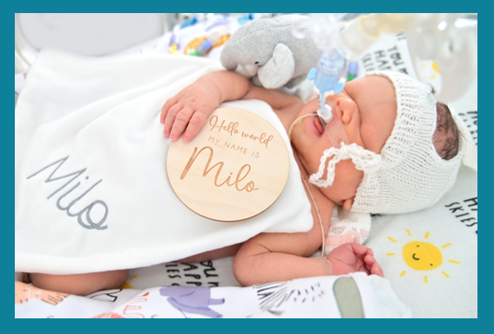







Milo’s Story

Slide 13
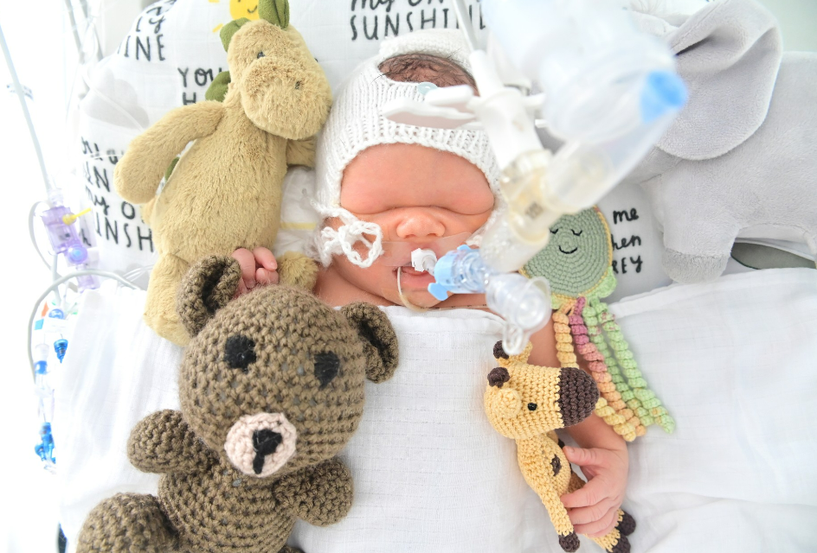
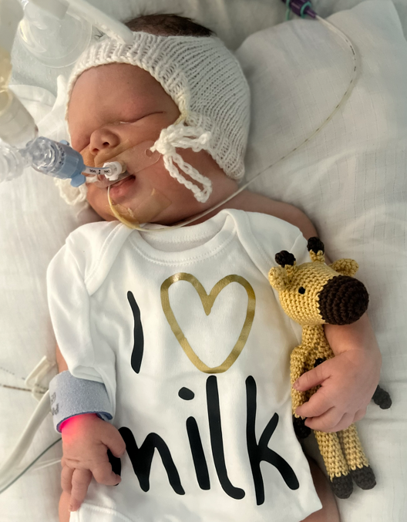
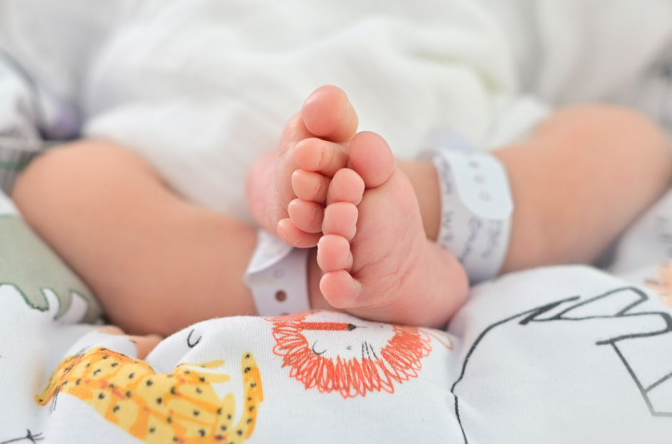
Our Boy
We received the devastating news that our beautiful boy had a poor prognosis at 31 weeks gestation, after what we had assumed was a healthy and uneventful pregnancy
To say the bottom of our world fell out is an understatement
We held onto every ounce of hope whilst realistically preparing for the worst
Milo was born at 38 weeks gestation and lived for 11 days
Milo was transferred from the NICU into our local children’s hospice, where he died a few hours later
We hope that he felt nothing but love during his short life, and especially in his final hours
It is an honour to speak about him, and the instrumental part that the Milk Bank has played in my journey as a grieving mum, whilst honouring my boy’s legacy

Slide 14
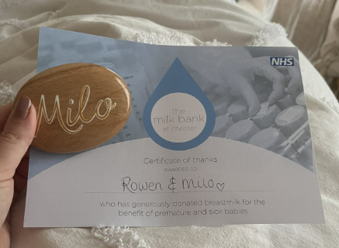
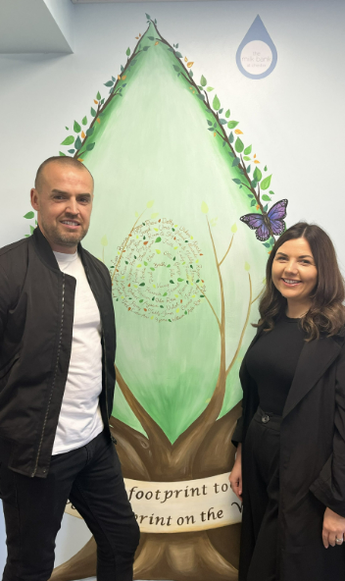
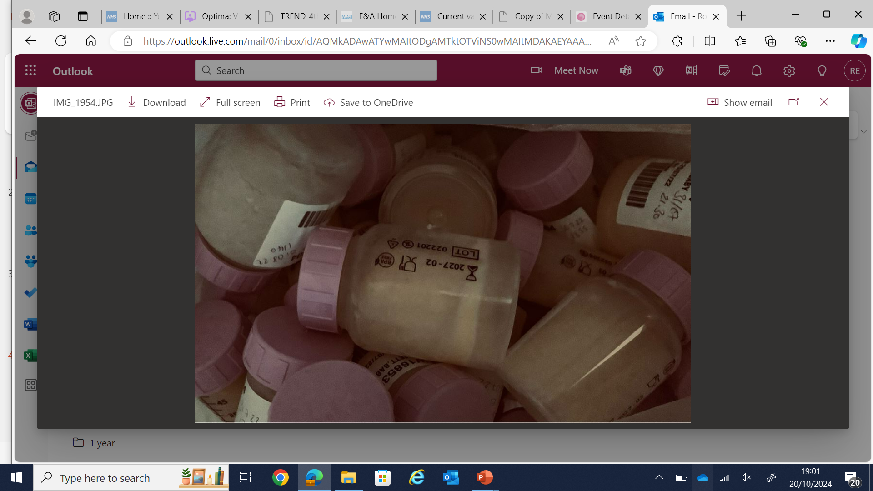
The Milk Bank
I first came to learn about donation after loss during one of my many late night google sessions leading up to Milo’s birth
I raised this in our birth planning meeting with our hospice and was told I would be able to do this, but did not really know much more
I began colostrum harvesting from 36 weeks of pregnancy, buying syringes from Amazon and scouring the web for aesthetically pleasing bonding cloths
I was referred to the Milk Bank at Chester whilst prepping for Milo’s transfer
After Milo’s death his remaining milk went to be used for research
I began Cabergoline to supress my milk production

Slide 15
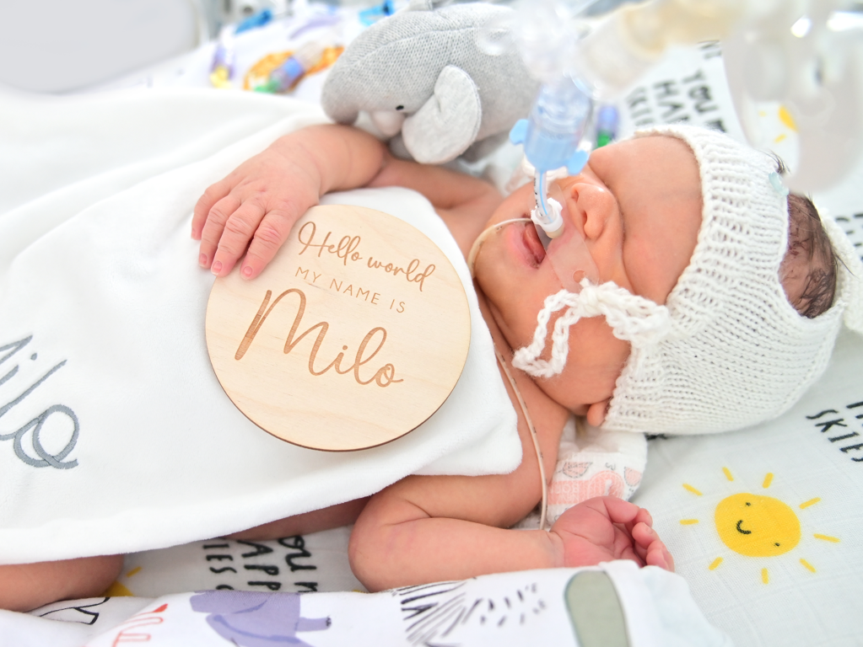
On Reflection
I would have liked to have had the opportunity to discuss colostrum harvesting and milk donation during my birth plan, including:
How to colostrum harvest
Where our local milk bank was located, and how they work
How analgesia may have an impact on how my milk would be utilised (particularly as I was having a planned c-section)
A discussion around the option of continuing to express to donate after death
The use of my expressed milk to comfort Milo during his final hours
These could have also been held whilst on the NICU, and preparing for hospice transfer
Learning that my milk could only be utilised for research due to the analgesia I had received was upsetting, and not something I envisioned on my expressing journey

Slide 16
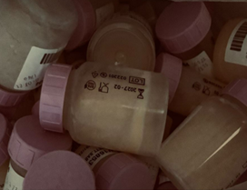







From a Parent
to Professional
Please park your own viewpoints over what you think you should and should not share with parents
Never assume
Speak sensitively and with empathy, but do not withhold information
If you do not know the information, or are uncomfortable delivering this, signpost, or ask a colleague to step in
Do not underestimate the comfort that bereaved parents find in being able to donate their baby’s milk and the legacy that this supports to create
Offer practical advice and support – or signpost to verified sources
Issue colostrum harvesting kits if you have these
Share with parents the Milk Bank @ Chester’s anticipatory care leaflet

Slide 17
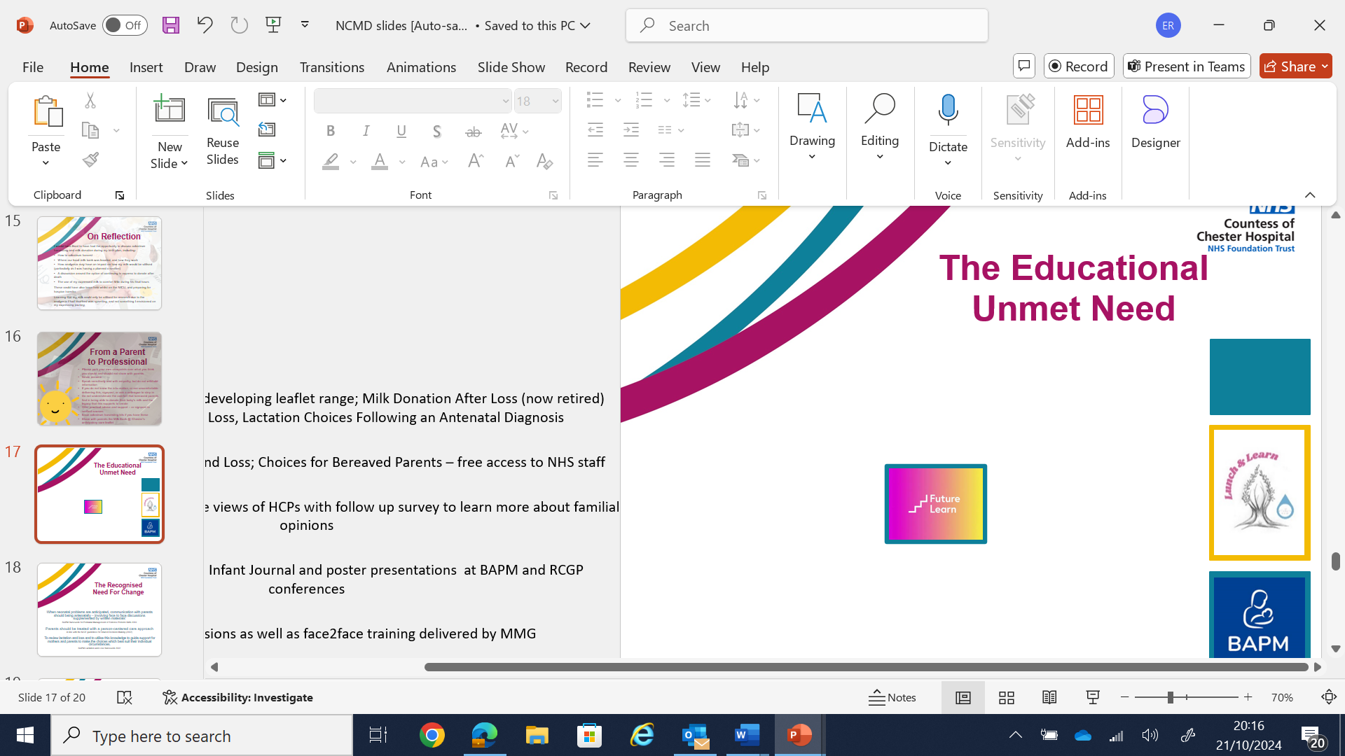
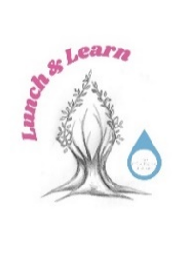
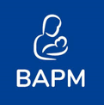
The Educational Unmet Need
Co production with families of developing leaflet range; Milk Donation After Loss (now retired) Breast care choices after Loss, Lactation Choices Following an Antenatal Diagnosis
Future learn course Lactation and Loss; Choices for Bereaved Parents –
free access to all NHS staff
National survey to understand the views of HCPs with follow up survey to learn more about familial opinions
Journal articles published in Infant Journal and poster presentations at BAPM and RCGP conferences
Lunch and Learn sessions and face-to-face training delivered by MMG

Slide 18
The Recognised Need For Change
‘When neonatal problems are anticipated, communication with parents should begin antenatally – involving face to face discussions supplemented by written materials’
BAPM framework for Perinatal Management of Extreme Preterm Birth (2019)
Patients should be treated with a person-centred care approach
in line with the NICE guidelines for Shared Decision Making (2022)
To review lactation and loss and to utilise this knowledge to guide support for mothers and parents to make the choices which best suit their individual circumstances
BAPM Lactation and Loss framework (2022)

Slide 19
A Clinical Data Reporting Process
The purpose of collating information nationally is to ensure that deaths are learned from, that learning is widely shared and that actions are taken, locally and nationally, to reduce the number of children who die
(National Child Mortality Database)

Slide 20
Our Ask
For information to be collated nationally
For all families to receive gold standard bereavement care with relation to lactation management
Families are empowered to engage in shared decision making to support them to make informed choices

Slide 21
Thank you all for your time and discussions.
Any questions?

Slide 22
Resources
www.milkbankatchester.org.uk/donationafterloss
www.ukamb.org/find-a-milk-bank
Educational Resource
https://learninghub.nhs.uk/Resource/51570/Item
Lactation After Loss: Choices for Bereaved Parents - Online Course - FutureLearn
Available on either platform:
Questionnaire for HCPs
https://app.onlinesurveys.jisc.ac.uk/s/newcastle/lactation-after-loss-nhs-staff-survey
Contacts
Laura Atherton – Operational Lead, the Milk Bank @ Chester
Laura.Atherton4@nhs.net
Sara Balmforth – Perinatal Midwife, the Forget Me Not Children’s Hospice
Sara.Balmforth@forgetmenotchild.co.uk
Rowen Emmett-O’Toole – Parent voice, Milo’s Mum
Rowen.Emmett@merseycare.nhs.uk
Please do not hesitate to get in touch, we’d love to support you in any way we can

